Slide 1
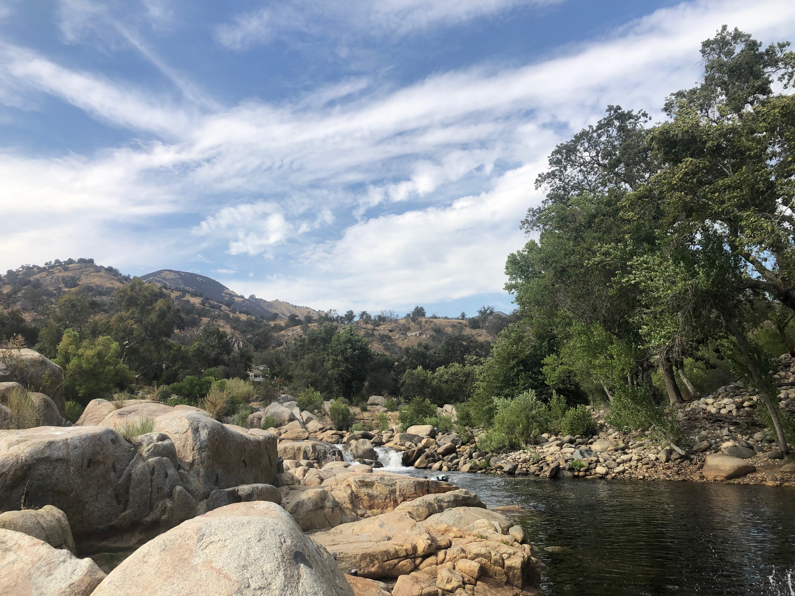
A Foster Child’s Path to Success
By: Cindy Cheng, Christine D’Amico, Eric Thomas & Jamila Vorise

Slide 2
Let’s Meet the Team

Slide 3
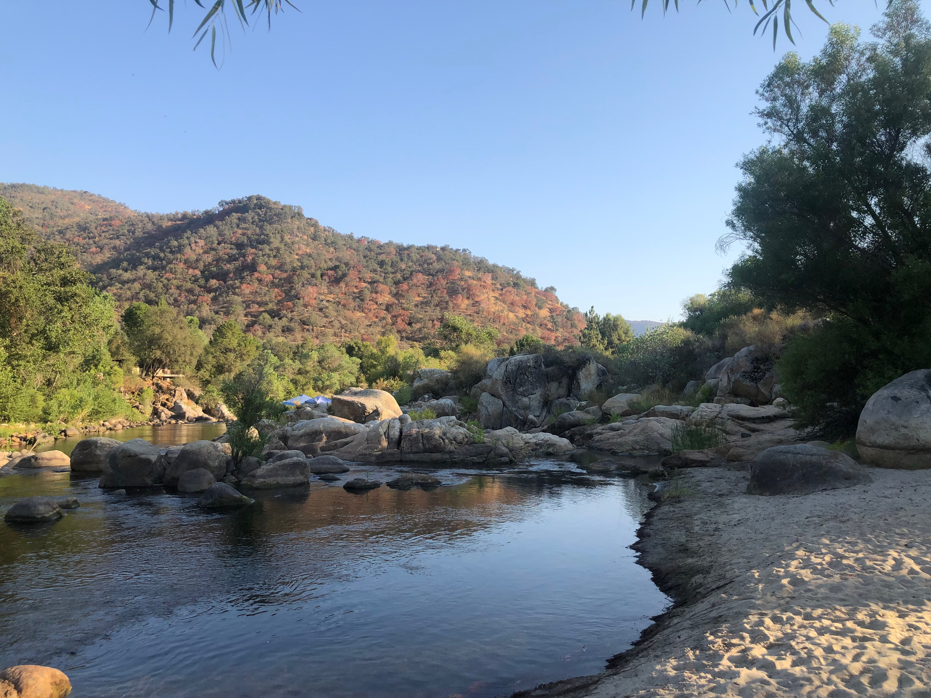
Agenda & House Keeping
Reflective Activities
Stats Activities
Flow Maps
Action Plan
Please mute your mic when you are not speaking
Parking lot – use the chat feature as a parking lot

Slide 4
Notes:
What are the characteristics of a river – write your responses in the

Slide 5
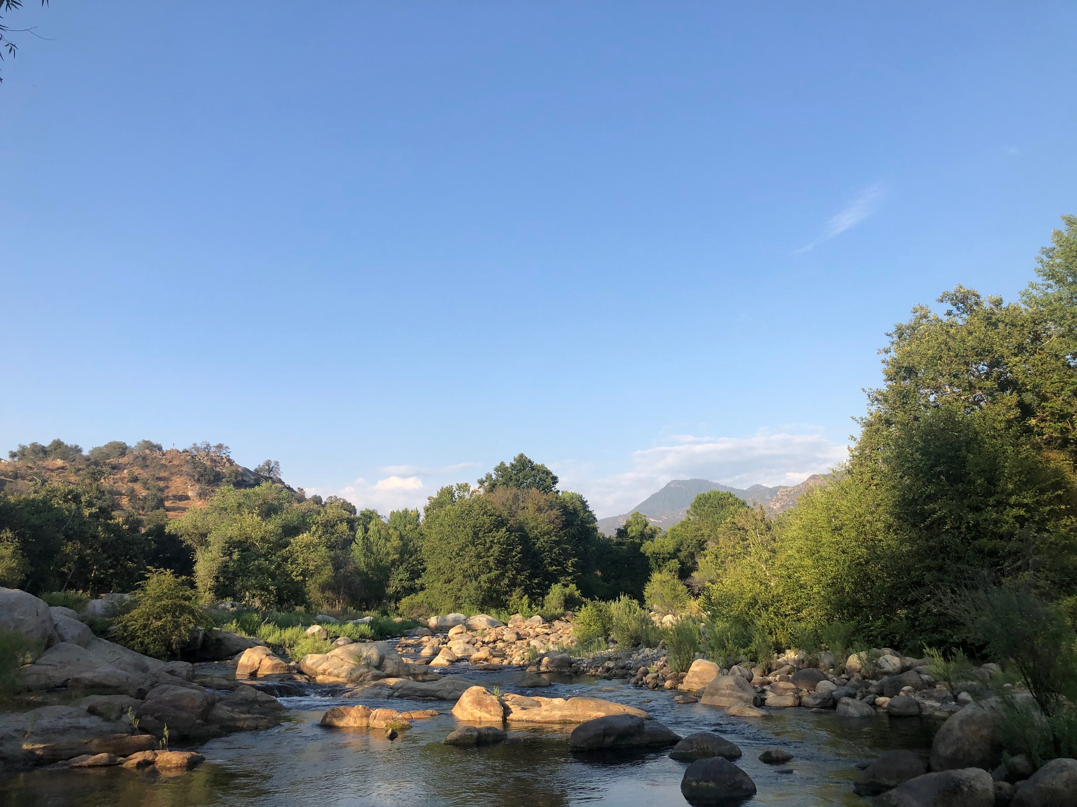

Slide 7
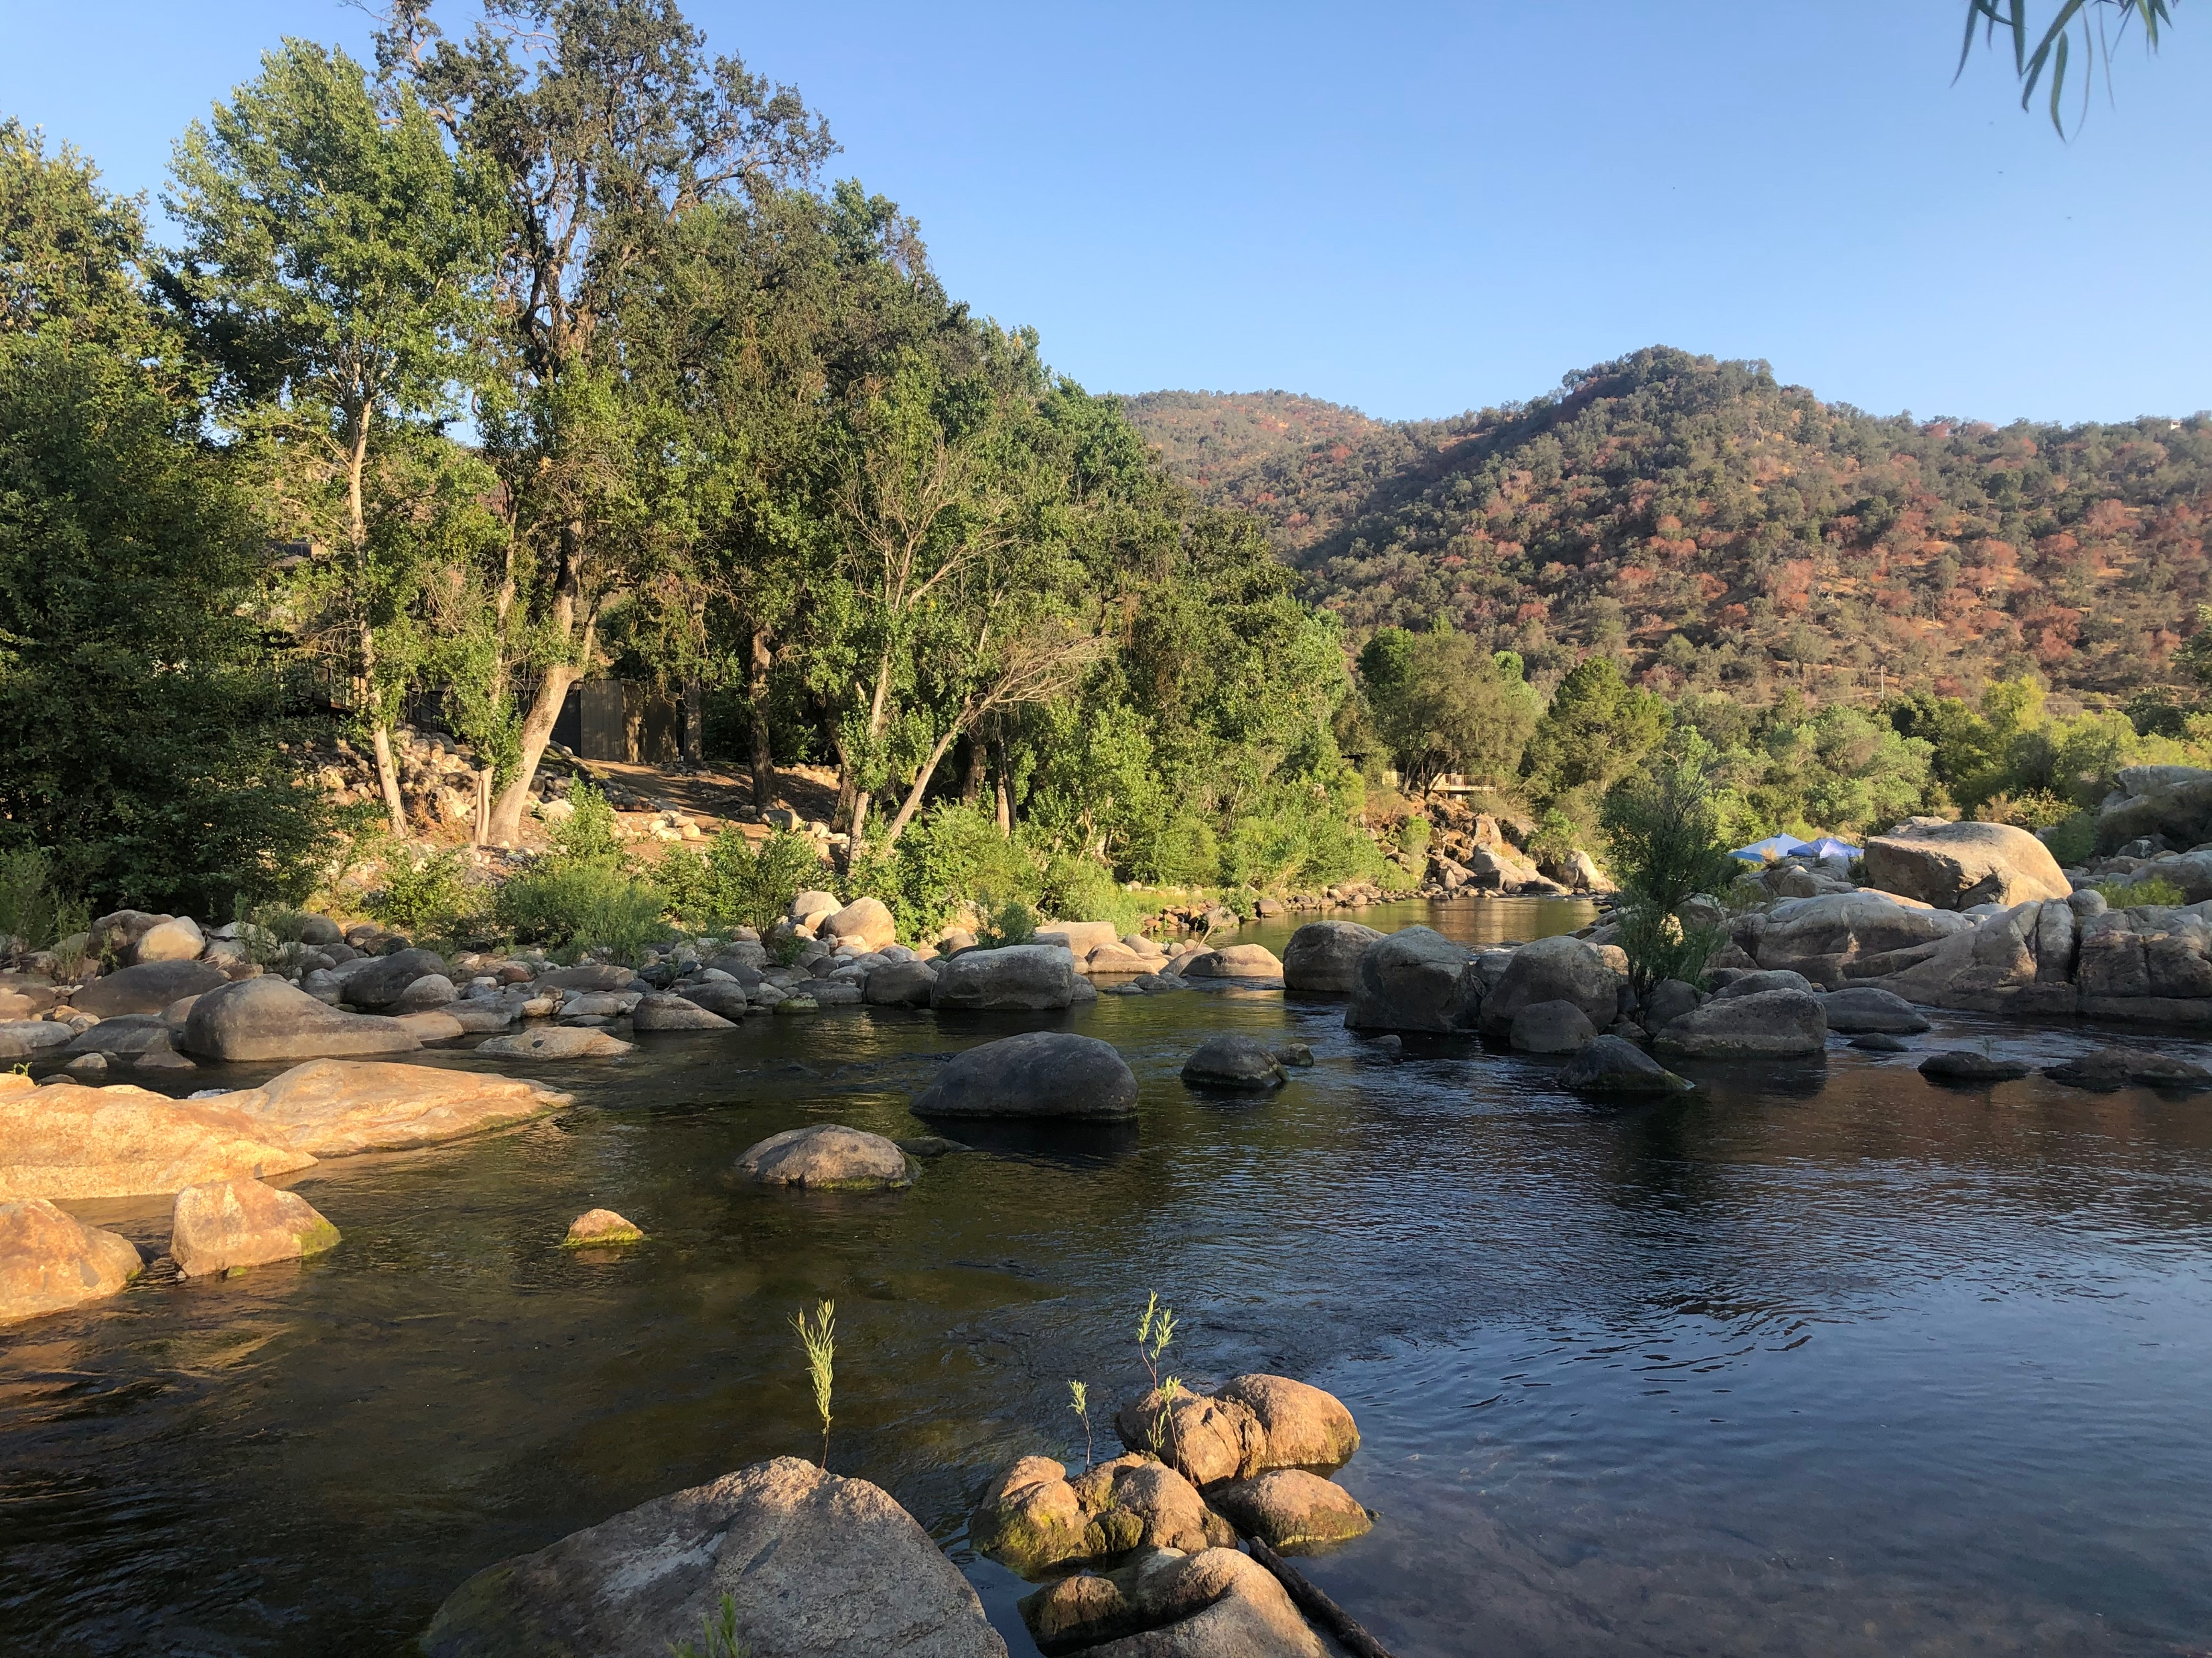

Slide 8
Reflection & then Discussion
HOW IS EDUCATION LIKE A RIVER?
Shared Padlet Here

Slide 9
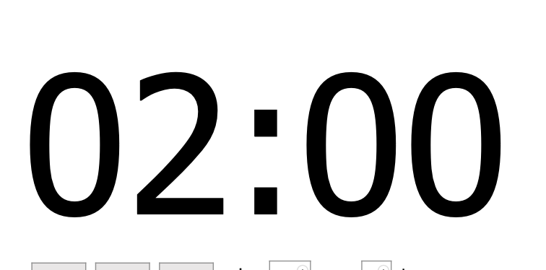

Slide 10
Small Groups
Group 1 –
Nicole Peters, Julie Montano, Karina Briseno & Patience Don-Willies
Group 2 –
Victoria Hamada, Kathryn Lawrence, James Cameron & Amberly Rivera
Group 3 –
Catherine McIlreavy & Kerri Schaub, Alyssa Harrison, Shanae Ganther
Group 4 –
Amber Yoshioka, Karen Knox, Terri May & Jennifer Miller
Group 5 –
Stephanie Thornburg, Kimberly Johns, Shante Morton & Elizabeth Crick
Group 6 –
Jessica Stadler, Alejandra Estorga, Amy Duffney & Steven Sandoval

Slide 14

What is foster care
A temporary service provided by the state when a child cannot live with his or her families.
Children in foster care may live with relatives or with unrelated foster parents.
Foster care can also refer children to be placed in group homes, care facilities, shelters and supervised independent living.
https://www.childwelfare.gov/topics/outofhome/foster-care/
This Photo by Unknown Author is licensed under CC BY

Slide 15

Foster children and why
Youth ranging from newborn to 18 years old who need care outside of their family.
Children enter foster care because:
Neglect
Mistreatment
Abuse
Children are from:
Different cultures
Different in strength, experience, needs and personalities
Children can be under foster care for days, weeks, months or years.
This Photo by Unknown Author is licensed under CC BY
https://slideplayer.com/slide/9413628/

Slide 16

Who are foster parents
Relatives are contacted to see if they can care for the child.
When child is placed with people who are not related him or her, the individuals who take care of the child are called “foster parents.”
Foster parent roles:
Provide stability, affection, guidance and consistency.
Provide permanent care or adopt the child.
This Photo by Unknown Author is licensed under CC BY-NC-ND
https://www.slideshare.net/sstewart1081/mgd-120-foster-care-ppt

Slide 17
Solo Write:
What words do you think of after you look at the pictures. you think of Foster care students succeeding in school: Link here
After you fill out the slides, speak about your words

Slide 18
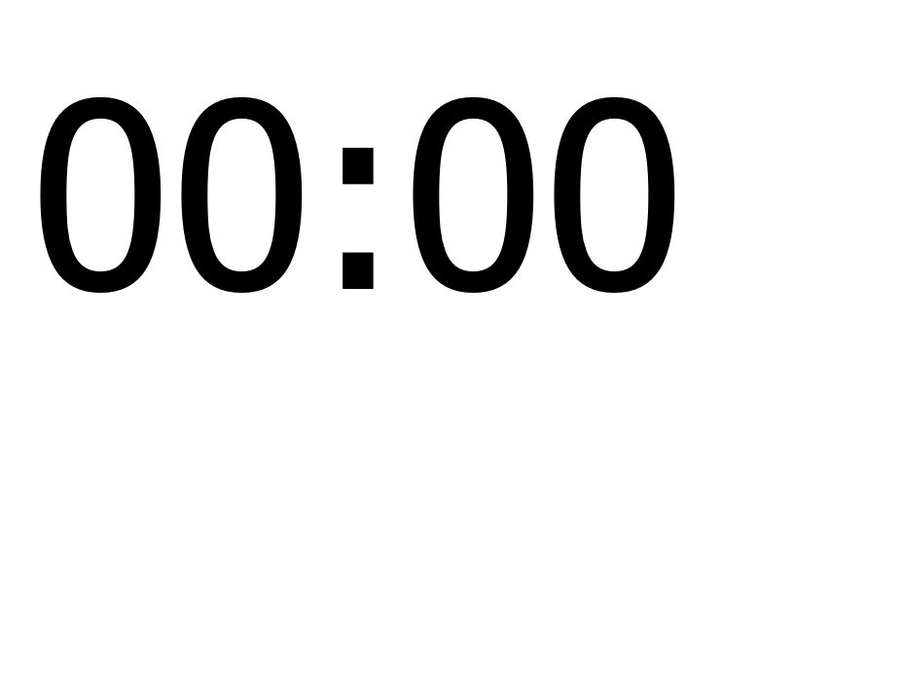

Slide 19
Current Foster Care Statistics

Slide 20
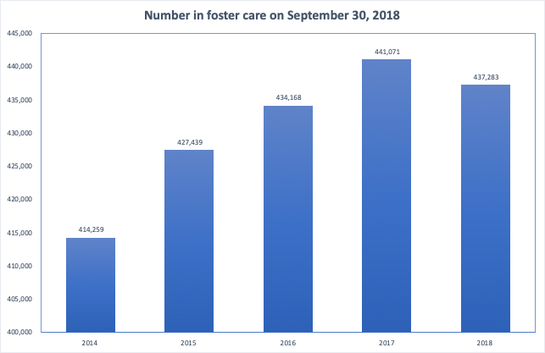
The number of children and youth in foster care is estimated to have grown at rate of 1.36% YOY from 2014 to 2018.
https://www.acf.hhs.gov/cb/research-data-technology/statistics-research

Slide 21
Age | Number | %
0 to 5 | 182,833 | 41.8%
6 to 10 | 101,506 | 23.2%
11 to 15 | 93,470 | 21.4%
16 to 20 | 59,294 | 13.6%
Most of the children in foster care are between the age of 0 to 5 as of September 30, 2018 FY
https://www.acf.hhs.gov/cb/research-data-technology/statistics-research

Slide 22
By Gender | Number | %
Male | 226,156 | 51.7%
Female | 211,083 | 48.3%
The ratio between male and female foster care children and youth is nearly equal on September 30, 2018
https://www.acf.hhs.gov/cb/research-data-technology/statistics-research

Slide 23
Race/ethnicity | Number | %
White | 193,117 | 44.4%
Black or African American | 99,025 | 22.8%
Hispanic | 90,688 | 20.8%
Two more races | 32,882 | 7.6%
American Indian/Alaska Native | 10,449 | 2.4%
Unknown/Unable to determine | 5,899 | 1.4%
Asian | 2,112 | 0.5%
Native Hawaiian/Other Pacific Islander | 1,053 | 0.2%
Majority of foster care children and youth are of White, Black or African American and Hispanic ethnicities on September 30, 2018.
https://www.acf.hhs.gov/cb/research-data-technology/statistics-research

Slide 24
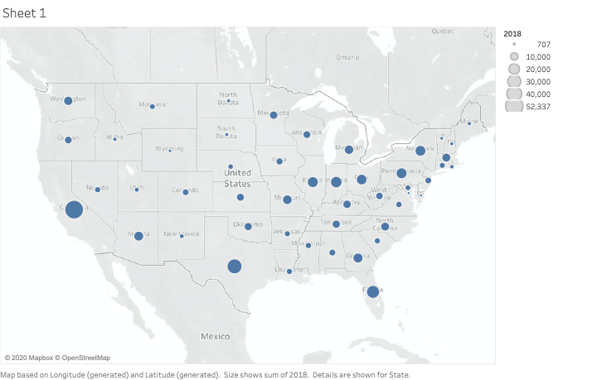
The state with the highest number of foster care children and youth is California (52,337)
https://www.acf.hhs.gov/cb/research-data-technology/statistics-research

Slide 25
What other statistics are you interested?
Use phone or computer, look for additional statistics and post them here
When posting your statistics, reflect and comment why these stats are important to you.

Slide 26
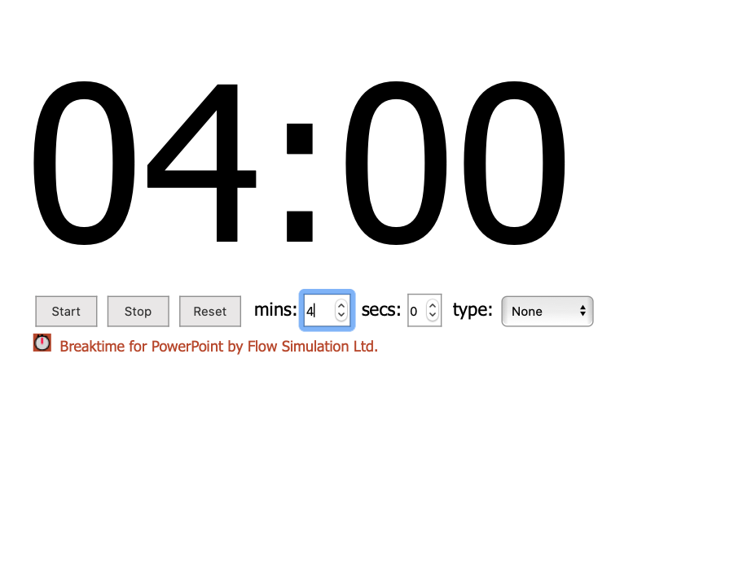

Slide 27
5 Minute Break
Parking lot

Slide 28
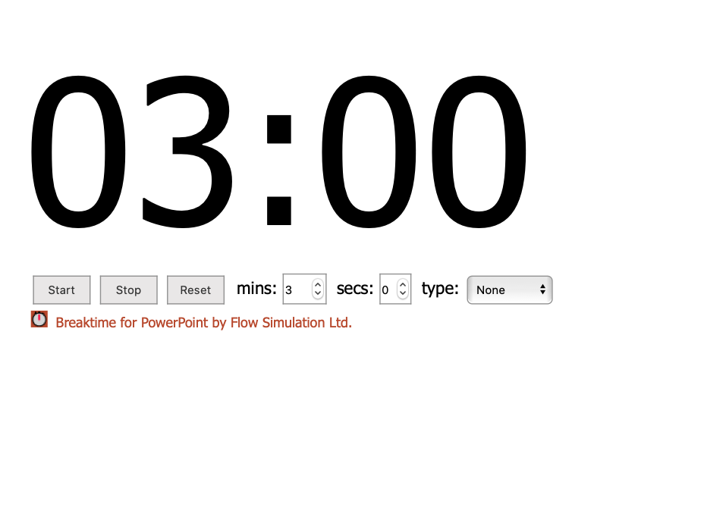

Slide 29
A Foster Child’s Path to School Success: Stocks Map
Youth and Community Engagement
Peers
Mentors, Coaches, councilors
Positive Role Models
Finding a Passion
Disaggregate Data
Foster Care Students Starts Here
Informed on school success requirements
Service Providers
Racism Sexism
Classism
Trauma Informed Strategies
College Admissions, Councilors, Housing Staff,
Risk Factors
School Culture, staff, knowledge
Trauma & Broken Relationships
Consistent Weekly Support
Stability, Structure & Advocacy
Gaps in Academic & Social Emotional Skills
Higher
Education
Begun
Quality & Quantity of Foster Parents
Invisible Achievement Gap
Higher
Education
Completed

Slide 30



A Foster Child’s Path to School Success: Flow Map
Vulnerable to negative influences
Isolation/depression
Lack of self esteem
early school years Relationship Focused Interventions
Peer Mentorship, a Sense of Belonging, Involved/Committed Foster Parents, Advocates
Fixed mindset
Fall through the cracks
Low self-awareness
Instability
Students caught in loops struggle with school success
early school years Mental Health/ Social Emotional Well-being
School Success: Heading to College
Stable Environment, Grit, Self-Advocacy, Self-Actualization
Student trauma goes unnoticed
Trauma repeated
into next generation
Caught in trauma cycle
Fixed mindset
early school years Trauma Informed Professionals
Including Foster Guardians, School Staff Members, College Bridge Programs
When students are caught in loops, society loses their gifts/talents, students minimize potential, society pays financial cost, family and friends affected in many ways

Slide 31

A Foster Child’s Path to School Success: Flow Map
Trauma Informed Professionals
Relationship Focused Interventions
Mental Health/ Social Emotional Well-being
This Photo by Unknown Author is licensed under CC BY-ND

Slide 32
Action Plan: How can we use this knowledge?
Reinforces the need for a Social Emotional Learning curriculum and the use of Restorative Practices.
Padlet – here
Brainstorm ideas of how you can bring this information to your teaching practice?
Where there any lightbulb moments?
Any questions?
Any specific areas that you still want to know more about?

Slide 33


Slide 34
NEYC
National Association for Teachers of Young Children

Slide 35
Thank you !!

Slide 36
The End

